Slide 1

ANALYSIS OF FACEBOOK LIVE
SELLERS DATASET
Submitted By:
Sharon Blessy J V
Indian Institute Of Information Technology Tiruchirappalli

Slide 2

Contents of the Dataset:
The Facebook Live Sellers in Thailand dataset contains information about the Facebook pages of 10 Thai fashion and cosmetics retail sellers.
Size of the Dataset:
The dataset has 7050 rows and 15 columns of data.
Missing Data in the Dataset:
No data items are missing in the dataset.

Slide 3

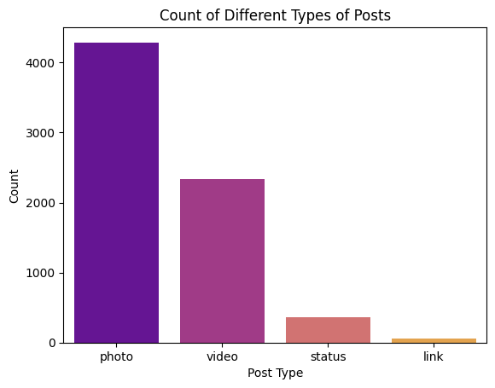
Time Range of the posts in the dataset:
Distribution of the type of post:

Slide 4
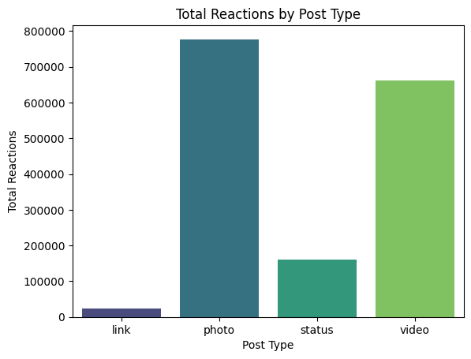
Distribution of the total reactions across different post types:

Slide 5
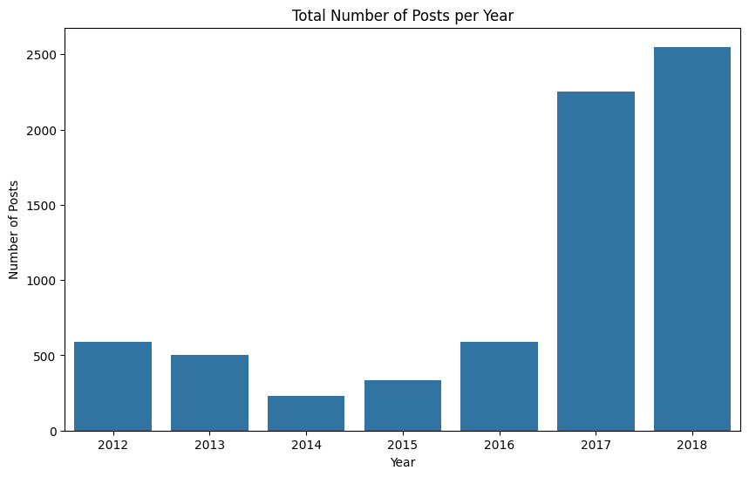
Distribution of the total no.of posts over the years:

Slide 6
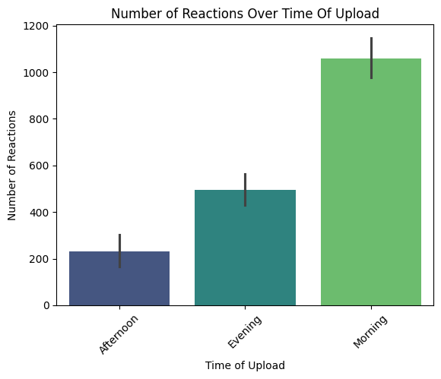
Number of Reactions based on time of upload:

Slide 7
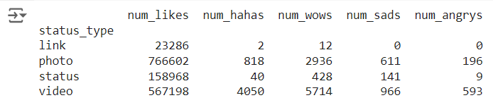
Distribution of no. of reactions (e.g., likes, loves, wow, haha, sad, angry) received on each status - type post.

